Slide 1


Slide 2
What is a chant?
Where do we hear chants?

Slide 3
How long can chants be?
Do they use instruments?
Do they have to rhyme?

Slide 4
Why do we chant when watching sports?
What makes a good chant?
Here’s one from the stadium.

Slide 5
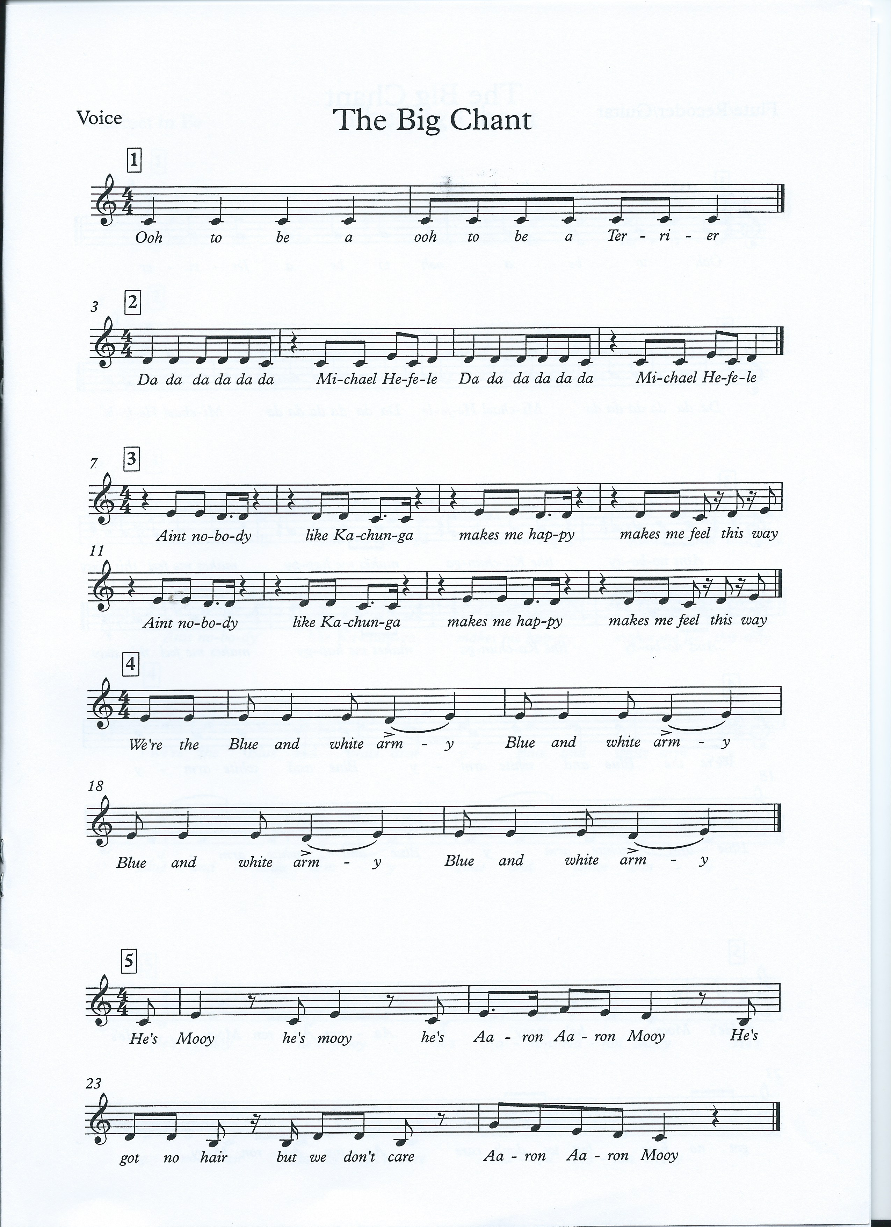
Here’s an example
Ooh to be a, ooh to be a Terrier
Your turn!
And this is what it looks like in music notation

Slide 6
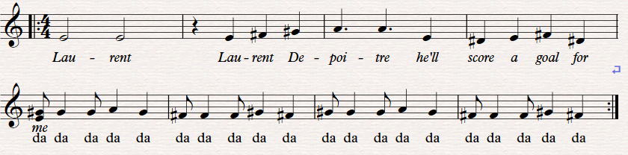

Slide 8
Work in small groups creating new lyrics, rhythms and melody for your chant.
Remember:
Create
Practice
Perform

Slide 9
Kamil Grabara
Joel Coleman
Ryan Schofield
Tommy Elphick
Terence Kongolo
Danny Simpson
Christopher Schindler
Florent Hadergjonaj
Herbert Bockhorn
Jaden Brown
Jon Stankovic
Rarmani Edmonds-Green
Jonathan Hogg
Isaac Mbenza
Trevoh Chalobah
Reece Brown
Alex Pritchard
Lewis O’Brien
Matthew Daly
Juninho Bacuna
Elias Kachunga
Adama Diakhaby
Karlan Ahearne-Grant
Josh Koroma
Fraizer Campbell
Collin Quaner
Steve Mounie
Danny Cowley
Nicky Cowley

Slide 10
Which other sports could you use to create new chants?
Which other teams could you use?
Which local festivals involve new compositions?
Huddersfield Contemporary Music Festival
Marsden Jazz Festival
Cleckheaton Folk Festival
Holmfirth Folk Festival
Shepley Spring Festival
For more information about other festivals please visit Creative Kirklees

